Slide 1
Audio Processing Objects

Slide 2
Origin
Introduced in Windows Vista, as a way to allow third party manufacturer to insert customised audio processing effects into Windows Universal Audio Architecture.
Allows for customisation of system audio and specialisation of audio drivers for different audio hardware.

Slide 3
An APO is effectively a black box processing unit The internal mechanisms of the APO are free to be whatever the designer chooses, however the processing must be lock-free, and the processing is recommended to be linear only.
APO’s can be implemented for use before the global mixer, as a render LFX or after the global mixer as a GFX.
APO’s have one instance per application for render LFX and a single instance for GFX application.

Slide 4
Theoretical Implementation
At it’s simplest, a custom APO can inherit CBaseProcessingObject which will implement all of the required interfaces to function correctly.
An APO is a type of COM object, meaning that an APO must also inherit the IUnknown class.
After compiling, the package must be WHQL signed to be able to distribute to users.
When in use, the APO runs as a Local Service on the machine with limited privileges.

Slide 5
COM Objects
A COM object is a binary standard that defines inter-process communication between a system and some process.
A COM object inherits from the IUnknown interface and is described using MIDL (Language extended from C) before being compiled and used / packaged into a DLL for use.

Slide 6
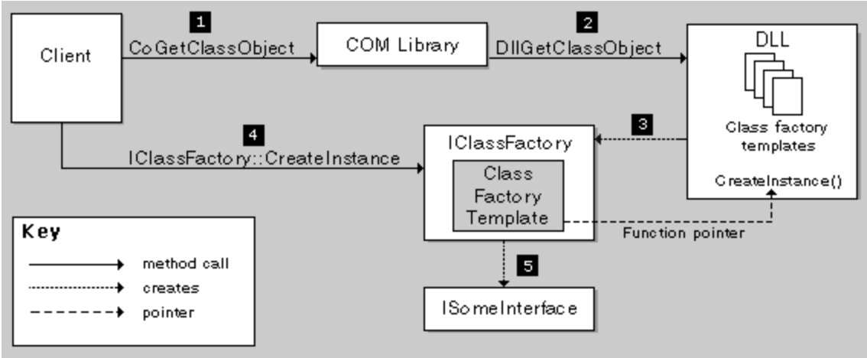
How a DLL and COM library provides the client with a user interface.
This COM interface can then be extended to contain custom methods that are useful to the client. This is the basis for the APO.

Slide 7
DLL Class Implementation
A DLL is used to package an APO and as a single reference file from which to build all the functionality of the object.
The DLL must expose the following methods in order for an APO to be built:
DLLMain - Used as an alternate DLL entry point, unused in this case
DLLCanUnloadNow - Called by client when uninitialising / garbage collecting, if no instances of the COM object are in use

Slide 8
DllGetClassObject - Called from COM library along with the CLSID of the APO, the IID of the interfaces used to access object functionality, and the pointer which will hold the ClassFactory instance. After GUID verification, this function will create the ClassFactory object as in previous diagram.
DLLRegisterServer / DLLUnregisterServer - Used by regsvr.exe to register/unregister the dll from the COM library with respective CLSID. Also provides ways to attach DLL to processes without being present in the target computers registry.

Slide 9
IClassFactory
The most important functions from the ClassFactory object:
QueryInterface - Used to give the ClassFactory object to the client through DLLCreateInstance. More generally it provides the pointers to each IID specified in it’s argument.
AddRef / Release: Increments and decrements the instance counter for the ClassFactory object, required to facilitate safe deletion of the object.
CreateInstance - Used by the client to create the APO object for use

Slide 10
CBaseAudioProcessingObject / APO
IAudioProcessingObject: This class provides a set of functions used by the client to initialise the APO.
IAudioProcessingObjectConfiguration: A configuration interface for processing
IAudioProcessingObjectRT: Real time processing unit of the APO, receives and processes audio buffer.

Slide 11
Registering an APO
An APO and it’s DLL package must have an associated CLSID for the COM library to be used by the system.
Registering the APO in the registry is done by regsvr.exe, with the DLL method call as discussed.
To install the APO and assign the appropriate hardware, as well as appropriate usage (RFX, GFX rendering) requires an additional .inf file to register, as well as digital certification if the APO is to be distributed.

Slide 12
INF/INX Files
An INF file contains all information pertaining to the manufacturer of the APO, the usage of the APO within the system, as well as associated hardware that the APO will be linked to (if the APO is for specific hardware devices).
An INX file is a more general version of the INF file, which can provide appropriate version/timestamps in an INF file with the use of the stampinf.exe utility in the EWDK.

